Slide 1
370 Tropical
Winter 2022

Slide 2

Tropical Meteorology is Important for Many Reasons
About 40% of the land surface. Large population.
Tropical storms, some of which influence the midlatitudes.
Interactions with the midlatitudes (e.g., El Nino, La Nina, atmospheric rivers)

Slide 3
Major Differences Between Tropical and Midlatitude Meteorology
Weaker temperature gradients and pressure gradients, in general.
Small Coriolis parameter (f). Less geostrophic near equator
Weather is far more steady day to day
More diurnal (sea breezes/precipitation)
Poorer data availability than in midlatitudes

Slide 4
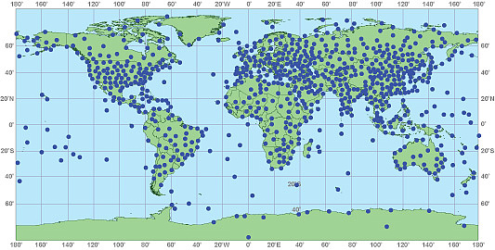
Upper Air Observations

Slide 5
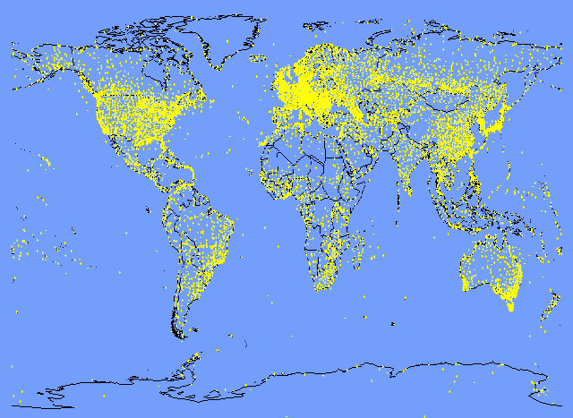
Surface Observations

Slide 6
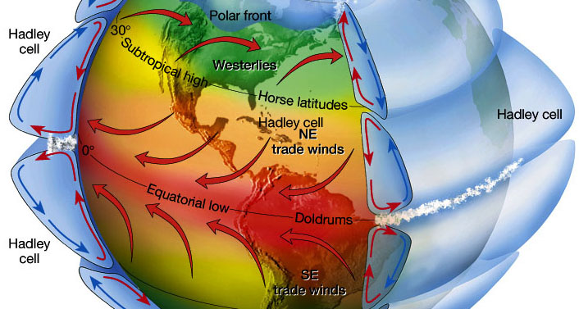
Large Scale Tropical Features
Hadley Circulation
Trade winds
ITCZ (Intertropical Convergence Zone)
ITCZ

Slide 7
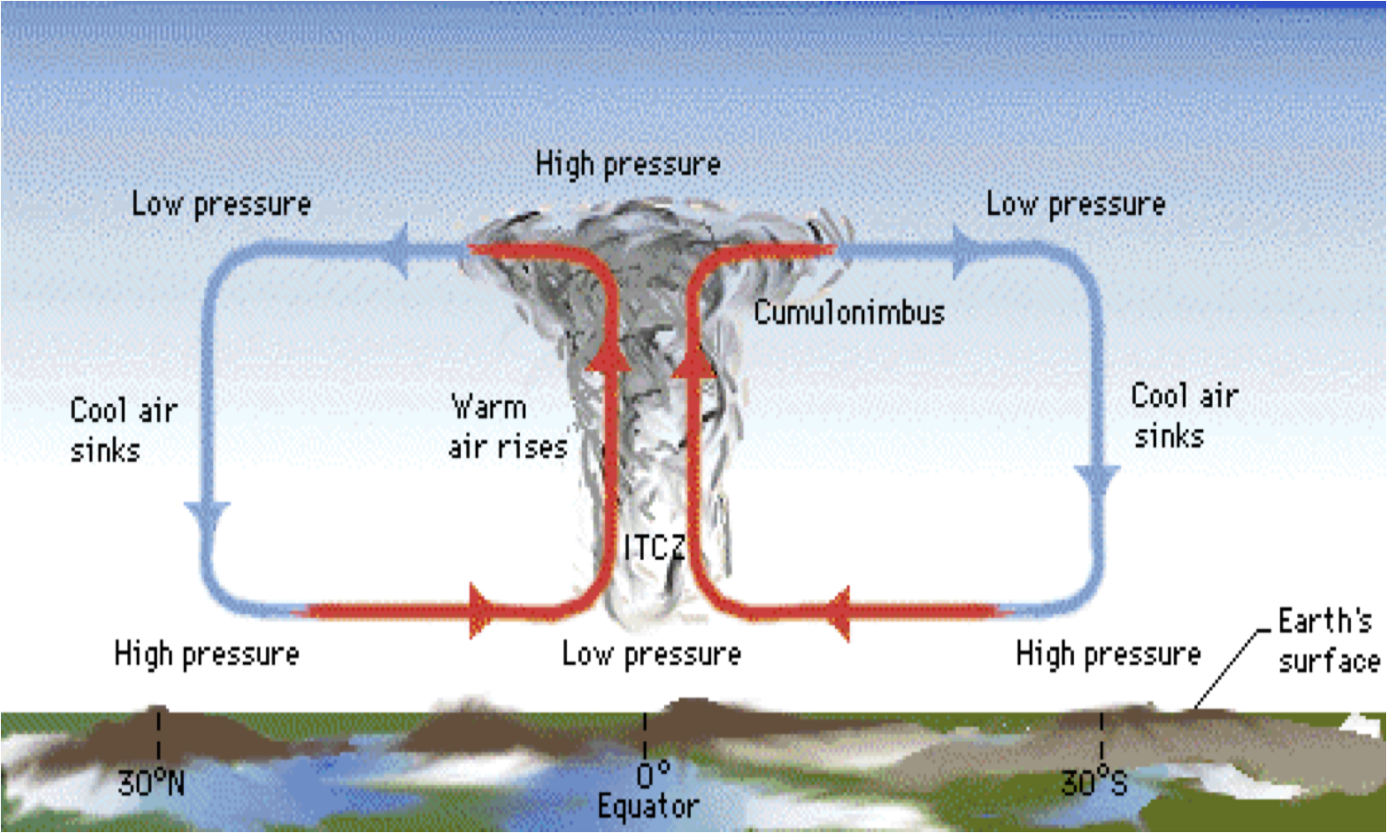
Hadley Cell (s)

Slide 8
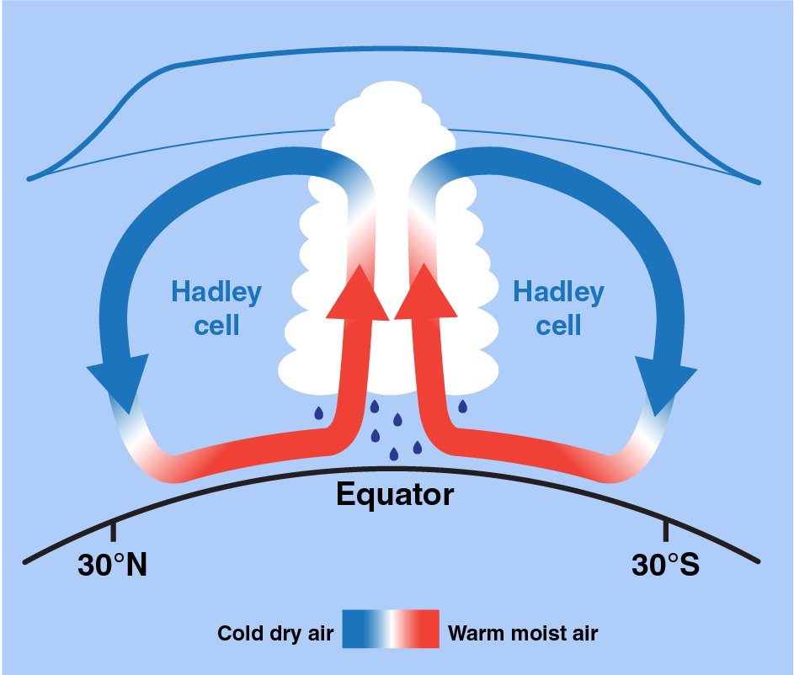
Correction to most ITCZ Schematics
The upward motion is concentrated near the ITCZ
The downward motion is spread out in latitude (roughly 15N/S and poleward) and weaker.

Slide 9
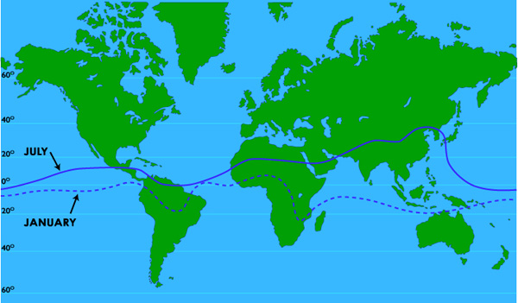
ITCZ is generally not on the equator
Moves northward during northern summer

Slide 10
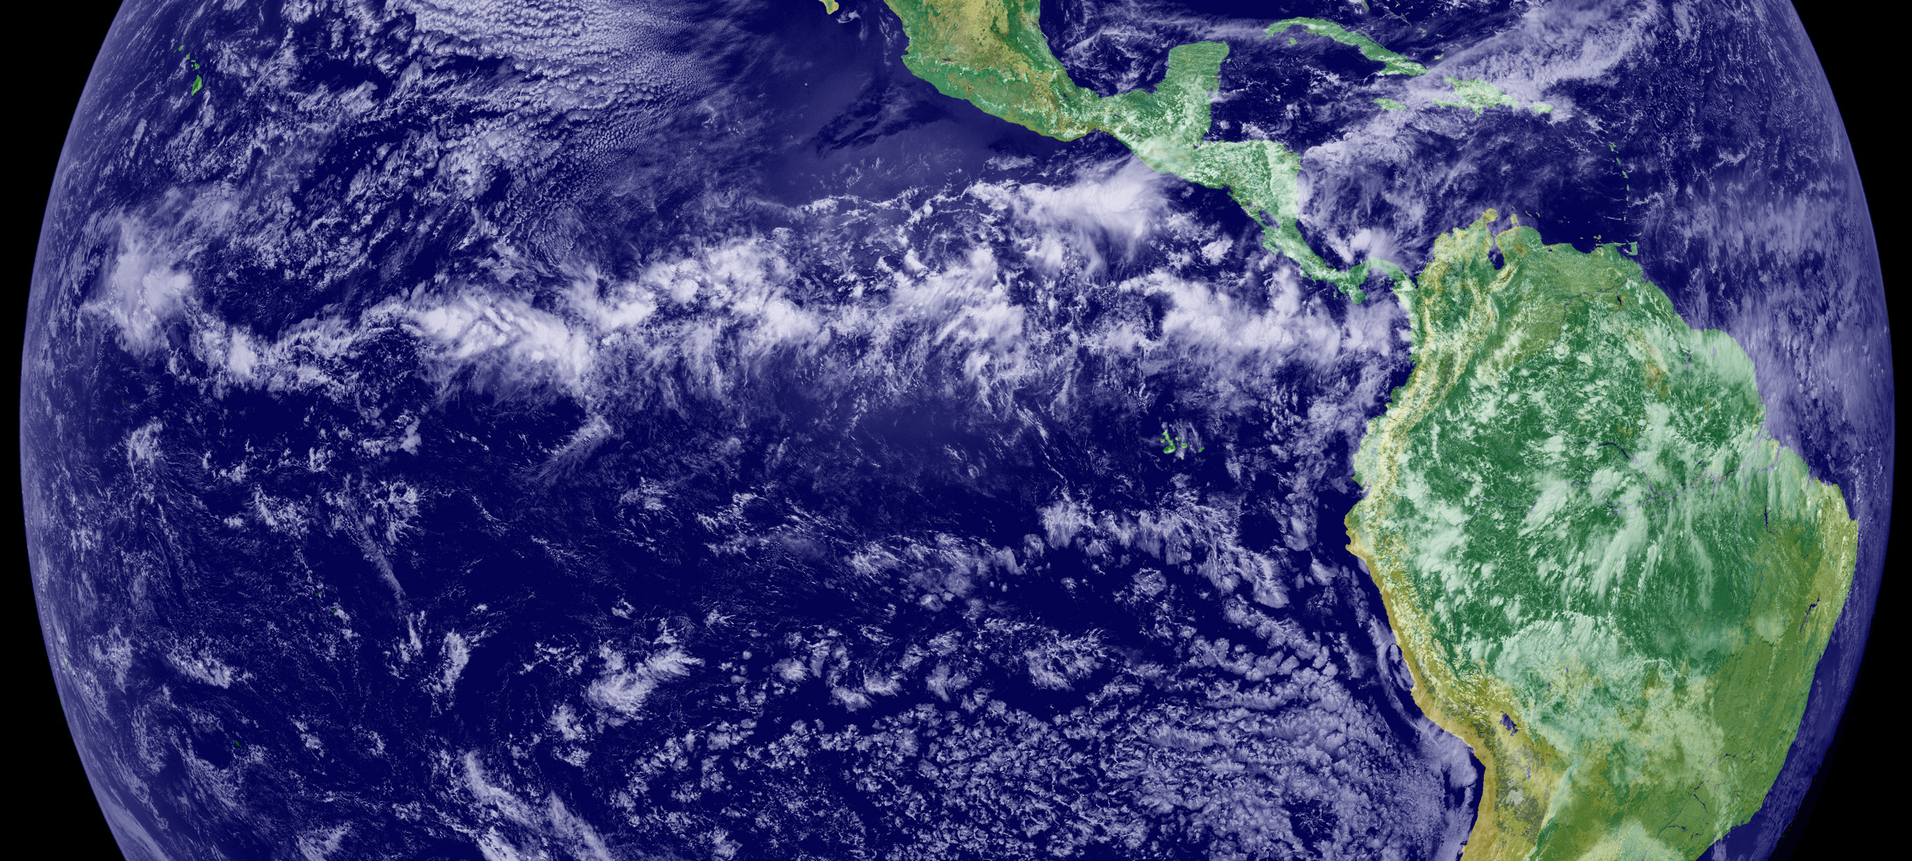

Slide 11
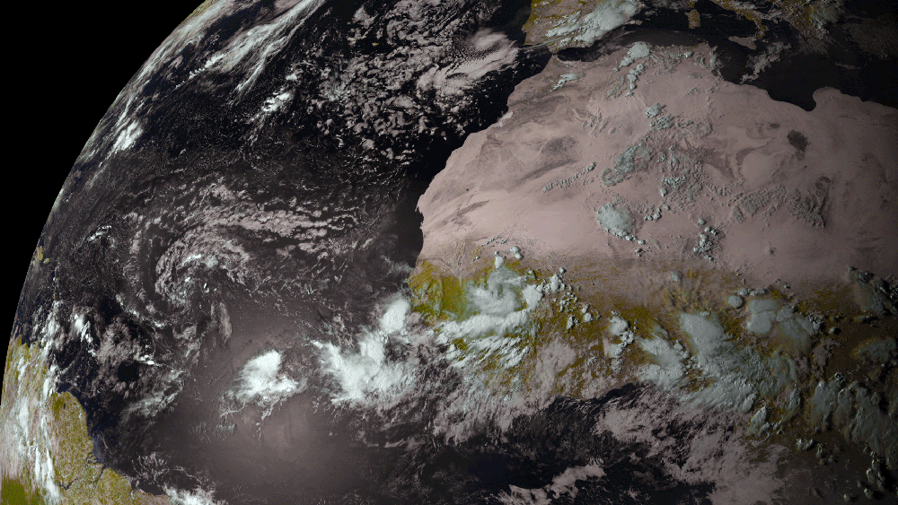

Slide 12
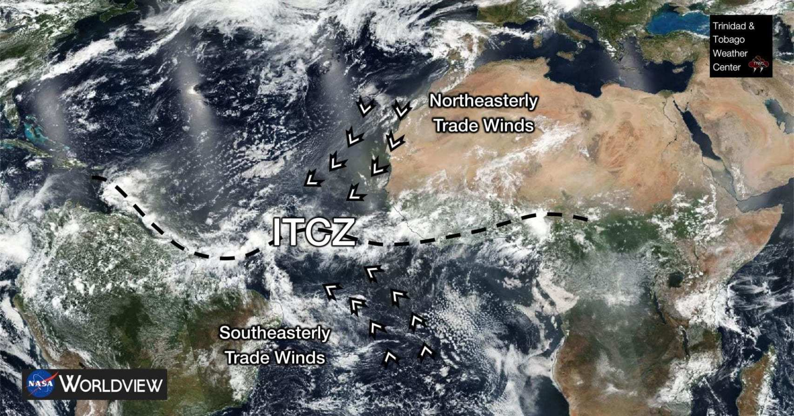

Slide 13
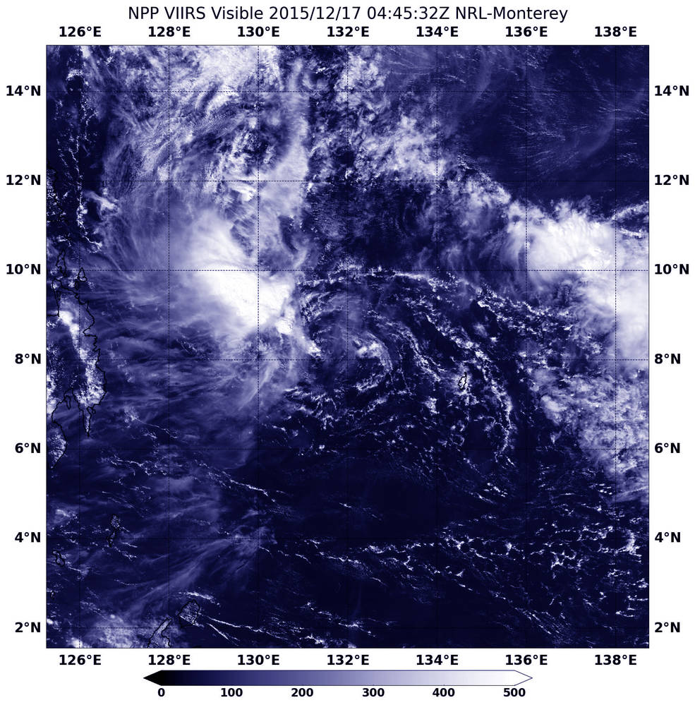
ITCZ made up of cloud clusters

Slide 14
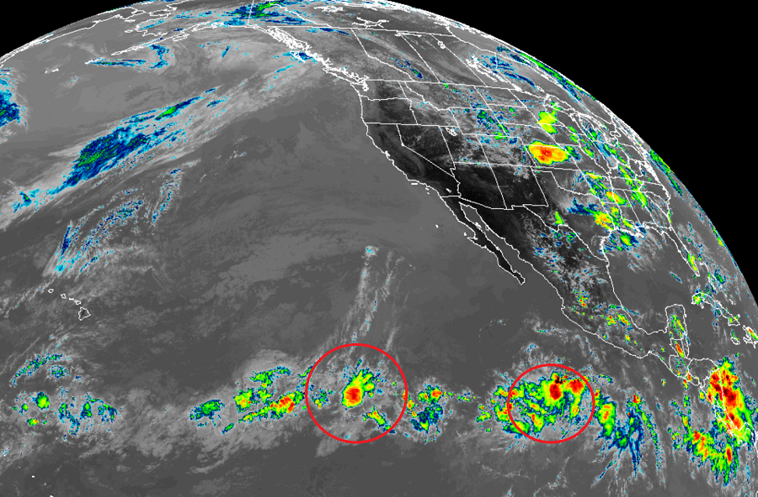

Slide 15
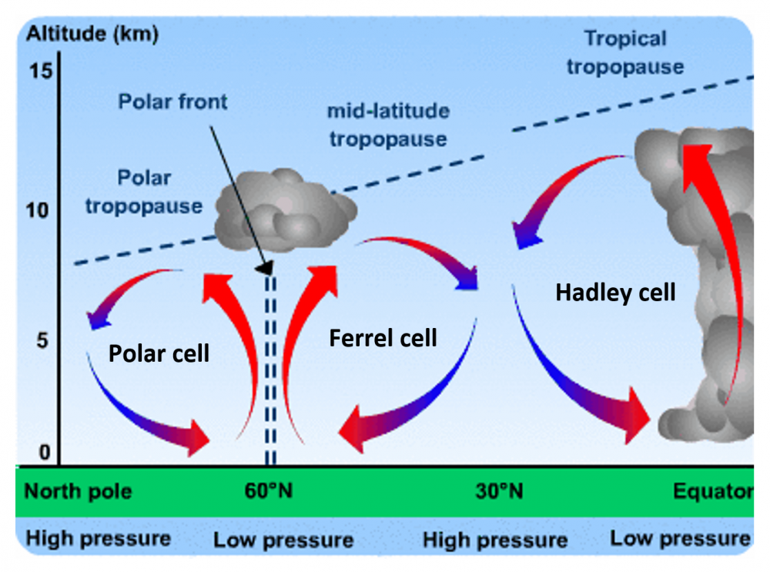
Sinking motion in the subtropics creates deserts in those latitudes (25-35 degrees from equator)

Slide 16
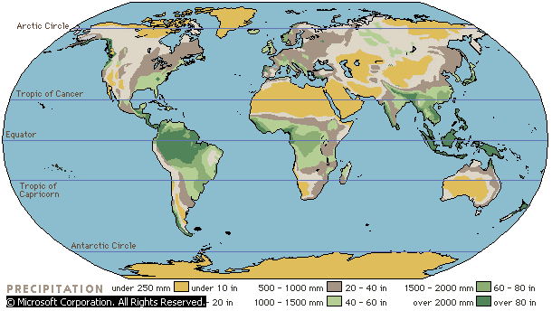
Major Deserts in the Subtropics

Slide 17
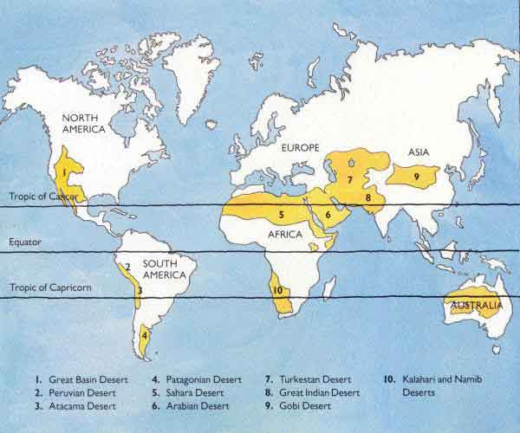
World’s Major Deserts

Slide 18
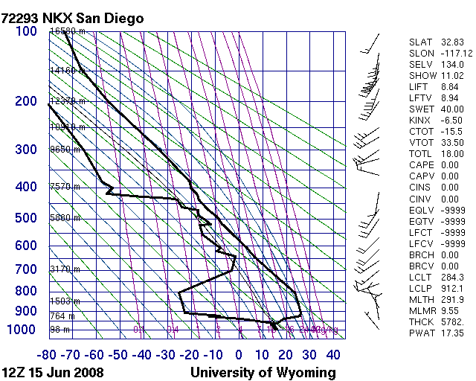
Trade Wind Inversions a.k.a. subtropical inversions
Produced by the sinking sinking air in the subtropics
A persistent feature of subtropical soundings that caps lower-tropospheric clouds and moisture.

Slide 19
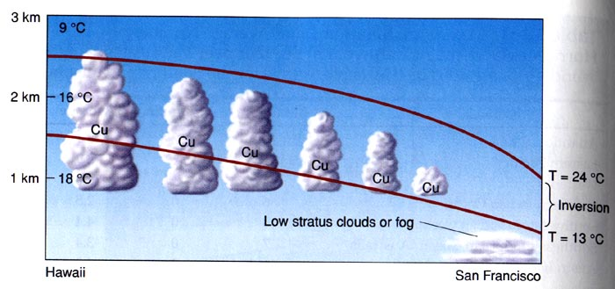
Strongest and lowest over eastern subtropical oceans

Slide 20
Low and strong

Slide 21
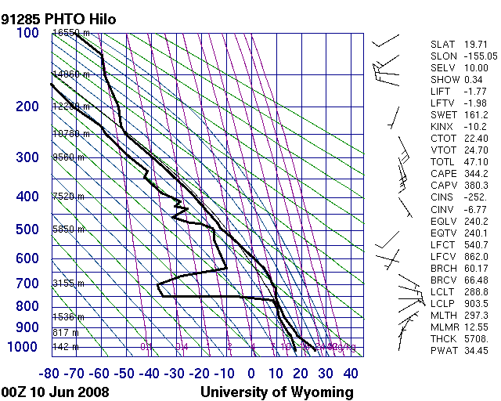
Higher and weaker

Slide 22
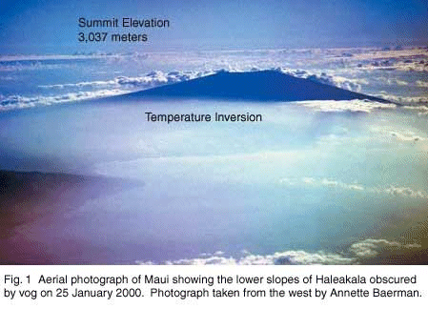

Hawaiian
View

Slide 23
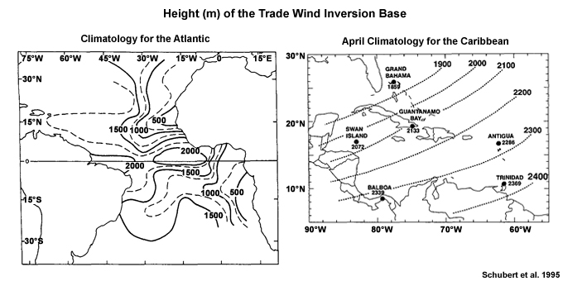
Trade Wind or Subtropical Inversion
The height of the base of the inversion varies from about 500 m om the eastern side of the subtropical highs to about 2000 m at the western and equatorial extremities.
The inversion is generally strongest when the height of its base is lowest, and vice versa. The thickness of the inversion layer varies from tens of m to more than 1000 m.

Slide 24
Height of Top of Trade Wind Inversion Base

Slide 25
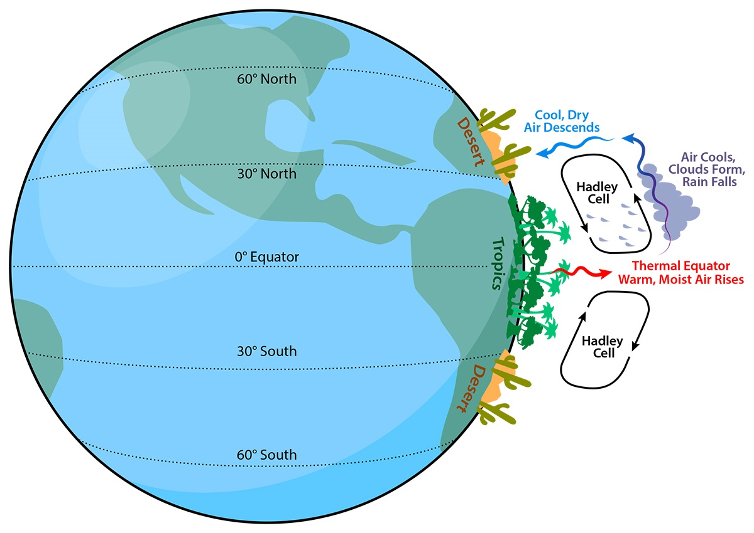
Why trade wind inversions? Subsidence from Hadley circulation and subtropical highs

Slide 26
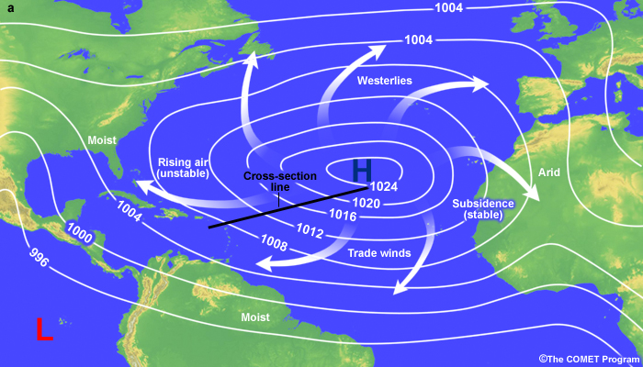
Subsidence is not zonally uniform: greater in the eastern side of the oceanic subtropical highs

Slide 27
Why does subsidence create inversions?
Descent is greater aloft and decreases towards the surface. More subsidence warming aloft
Well-mixed marine layer near the surface.
Large adiabatic warming
Weak adiabatic warming

Slide 28
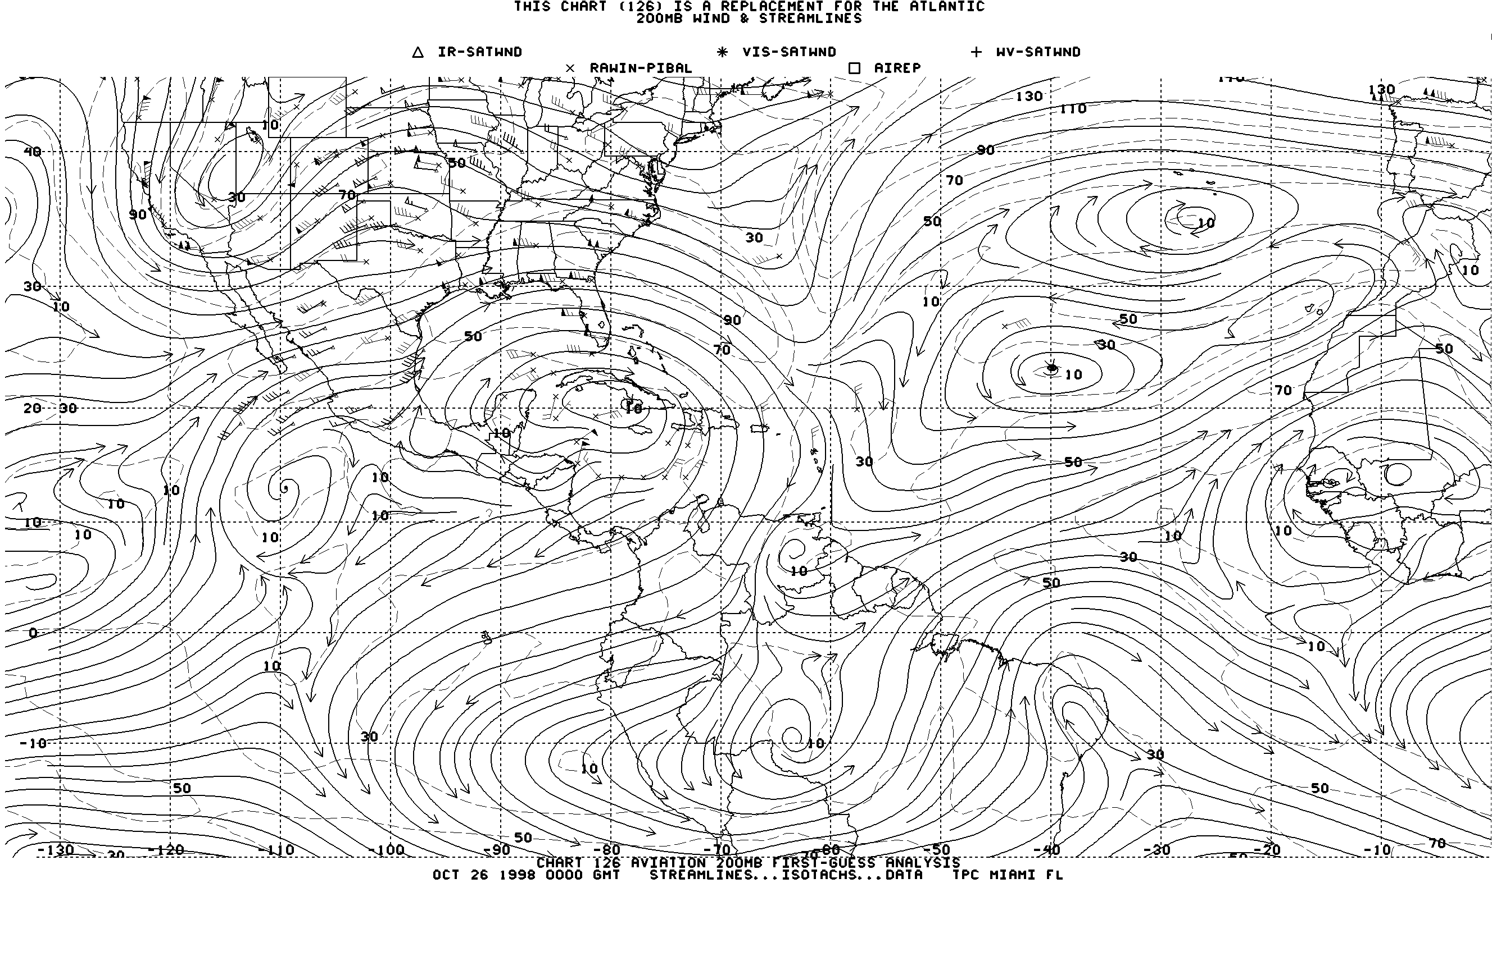
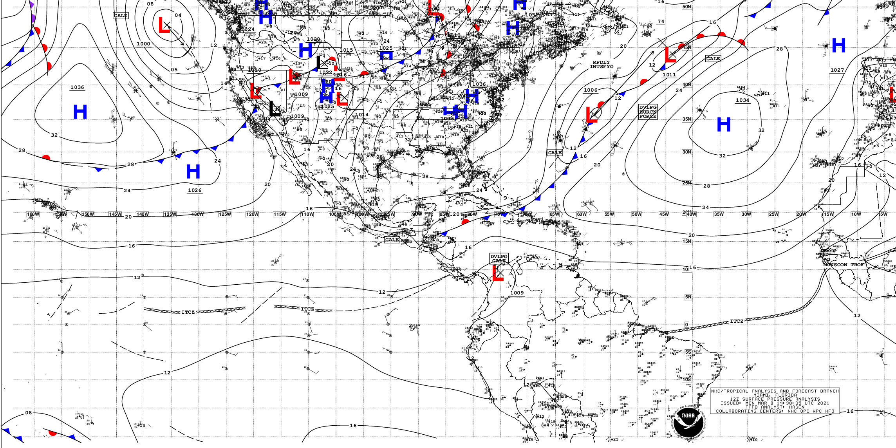
Tropical Analyses
Both midlatitude style, isobaric analysis, and streamline/isotach analyses.
Why the latter is most popular in the tropics?

Slide 29
Streamline-Isotach Analysis

Slide 30
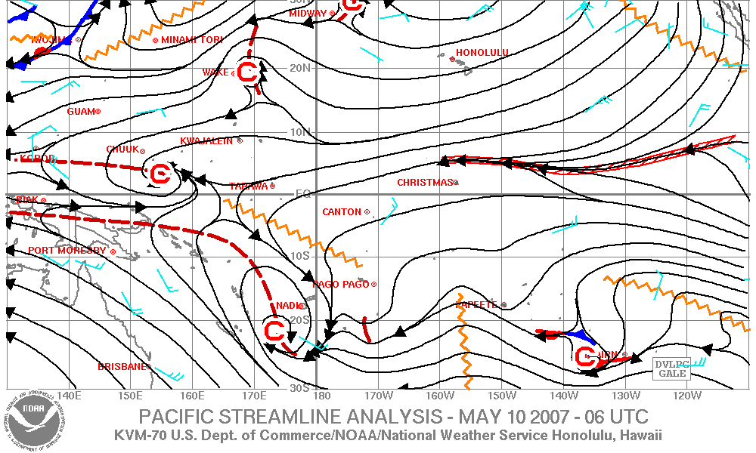
Streamline Isotach Analysis

Slide 31
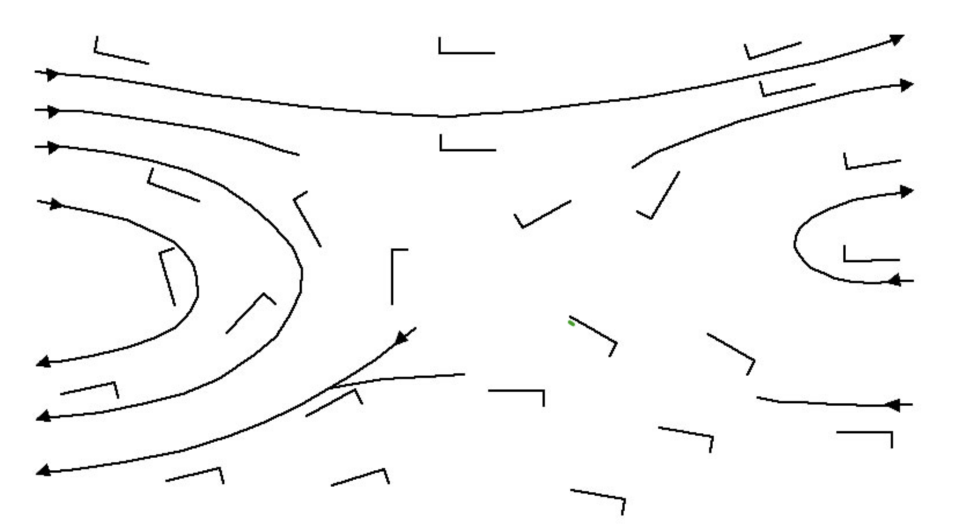
Review
A streamline is a line everywhere parallel to the instantaneous flow.
An isotach is a line of constant wind speed.

Slide 32
Why are streamline/isotachs better than isobars/heights in the tropics?
Flow is not geostrophic within roughly 5 degrees of the equator (so connection between pressure and winds is not necessarily straightforward)
Lot of pibals (just winds) in the tropics compared to radiosondes.
Pressure variations normally weak in the equator (large noise to signal)

Slide 33
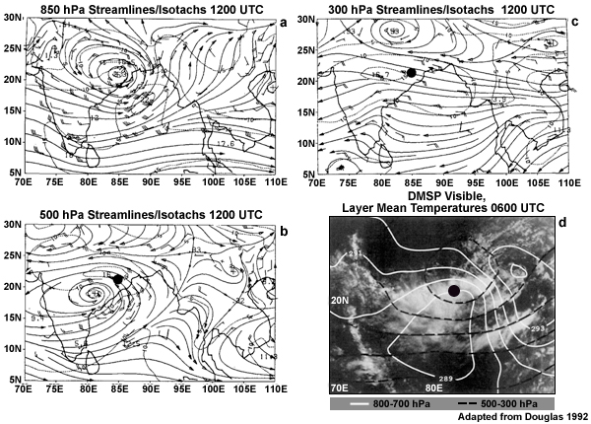
Whynot analyze winds instead of pressure?

Slide 34
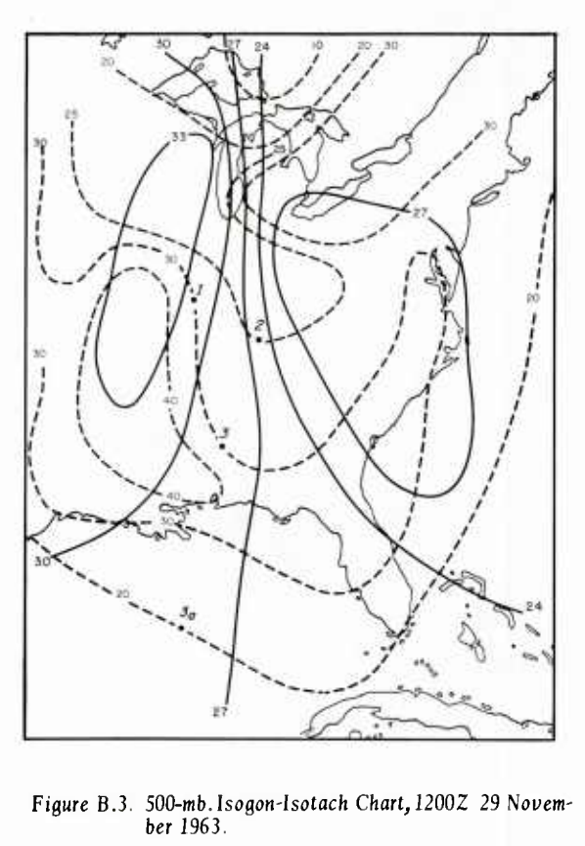
Streamline/isotach analysis is generally used but there are alternatives (isogon, isotach)
Not intuitive

Slide 35
Streamline/isotach Analysis
Helps to remember component wind circulations we studied earlier and how they combine:
  Translation
  Divergence/convergence
  Rotation
  Deformation

Slide 36
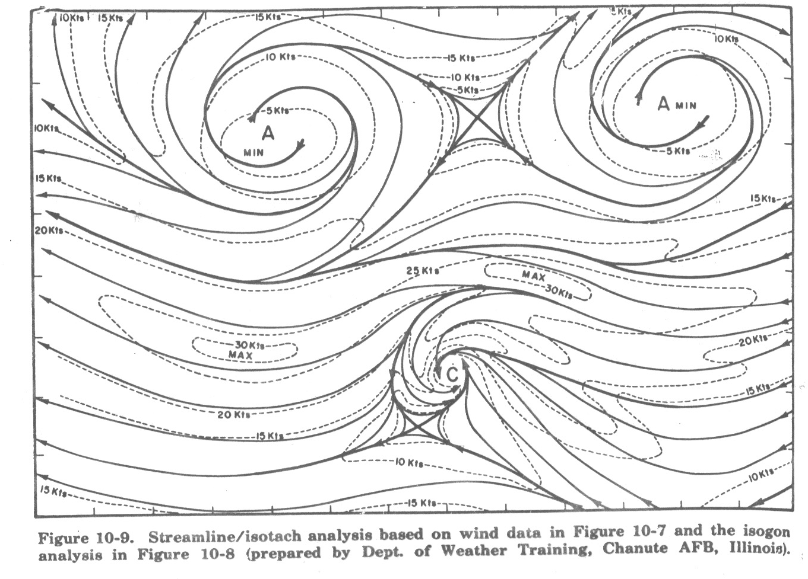

Slide 37
Streamline/isotach analysis
Winds should go to zero at singular points:
  Centers of rotation
  Centers of convergence/divergence
  Centers of deformation

Slide 38
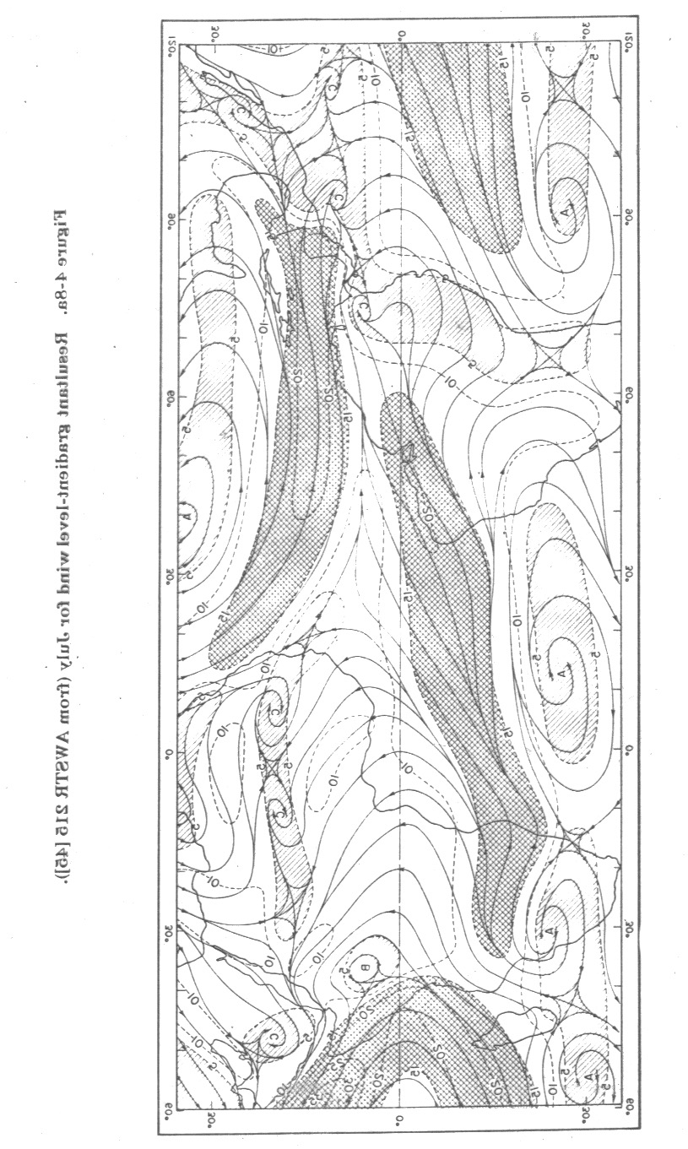

Slide 39
Easterly Waves:
The Major Synoptic Disturbances in the Tropics
Westward moving synoptic waves characterize the tropics
Tropospheric waves that modulate clouds/rainfall and move westward at ~5-10 m/s and have wavelengths of 2000-4000 km.

Slide 40
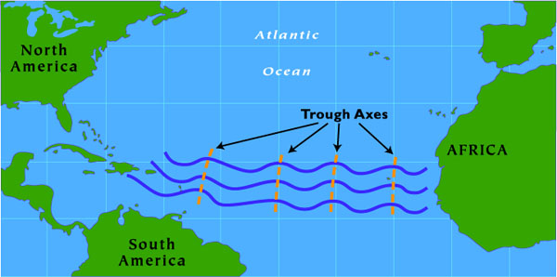

Slide 41
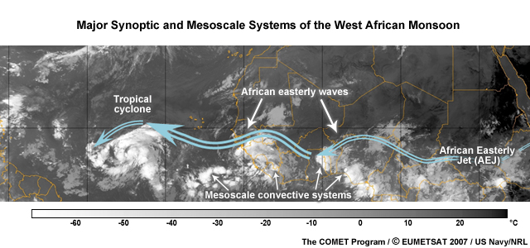

Slide 42
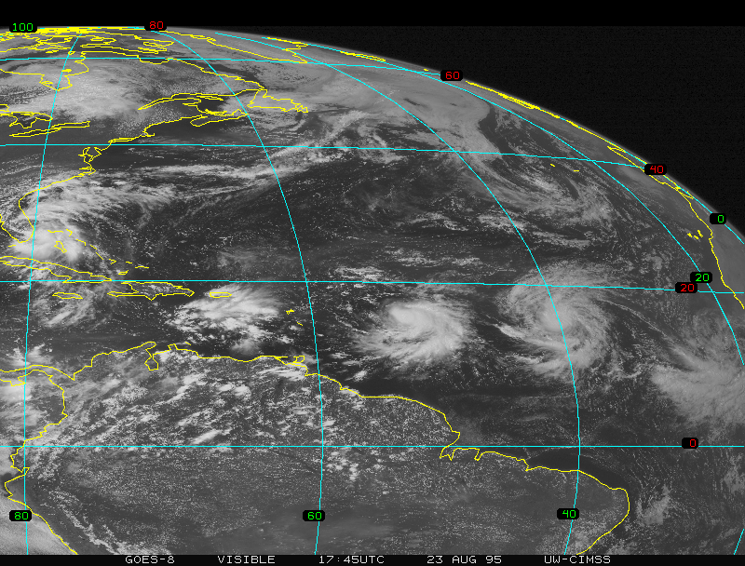

Slide 43
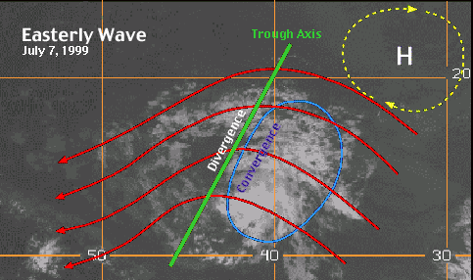
Trough or Ridge?

Slide 44
Trough or Ridge?

Slide 45
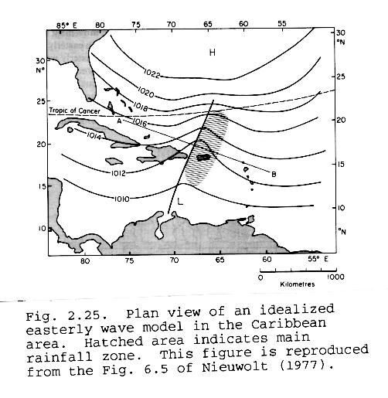

Slide 46
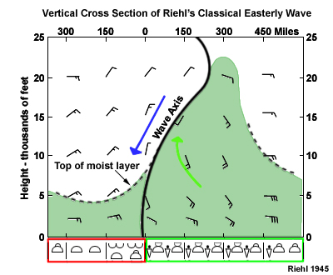
West
East

Slide 47
Many easterly waves originate over Africa and are known as African Easterly Waves

Slide 48
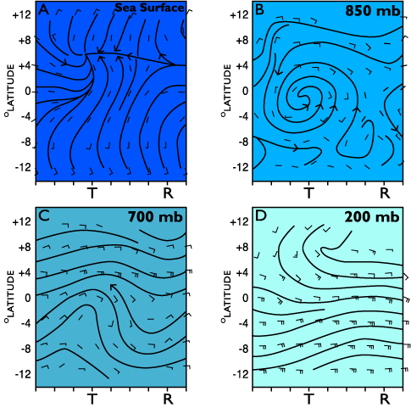
Composite African Wave Structures (Reed et al., 1977)

Slide 49
African Easterly Waves Are Closely Associated with and Propagate within a Midtropospheric Easterly Jet Originating Over Africa
Maximum amplitude centered around 650-700 hPa near 15N
Associated with large temperature difference between the hot Sahara and cool Gulf of Guinea

Slide 50
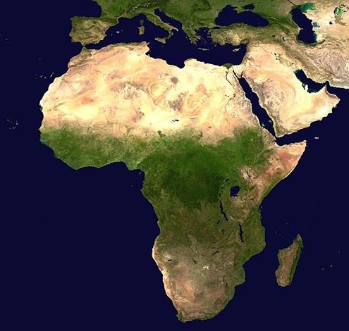
HOT
Cool

Slide 51
The Mean State over West Africa: The African Easterly Jet (AEJ)
Burpee, R.W. 1972 The origin and structure of easterly waves in the lower troposphere of North Africa, J. Atmos. Sci. 29, 77-90
Why is the AEJ there?

Slide 52
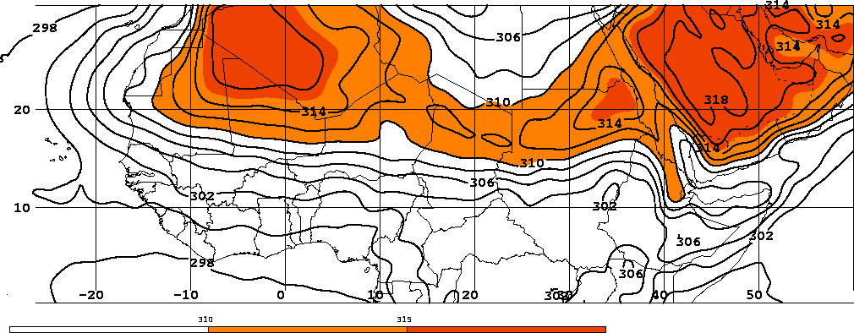
Hint: Surface temps and thermal wind equation!
HOT
COOLER
Large temperature gradient between 10º-20ºN

Slide 53
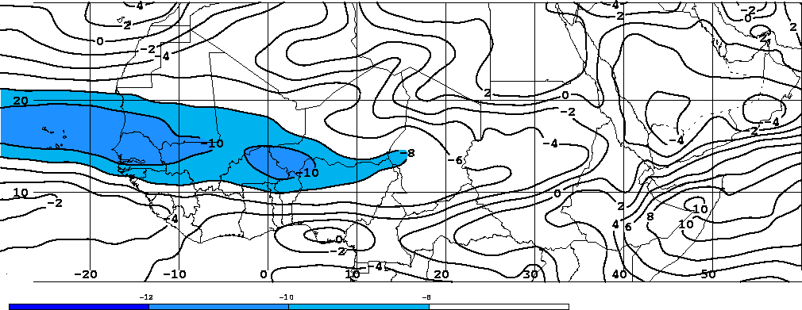
Zonal wind accelerates over Africa!
Mean 700hPa U wind, 16th July – 15th August 2000

Slide 54
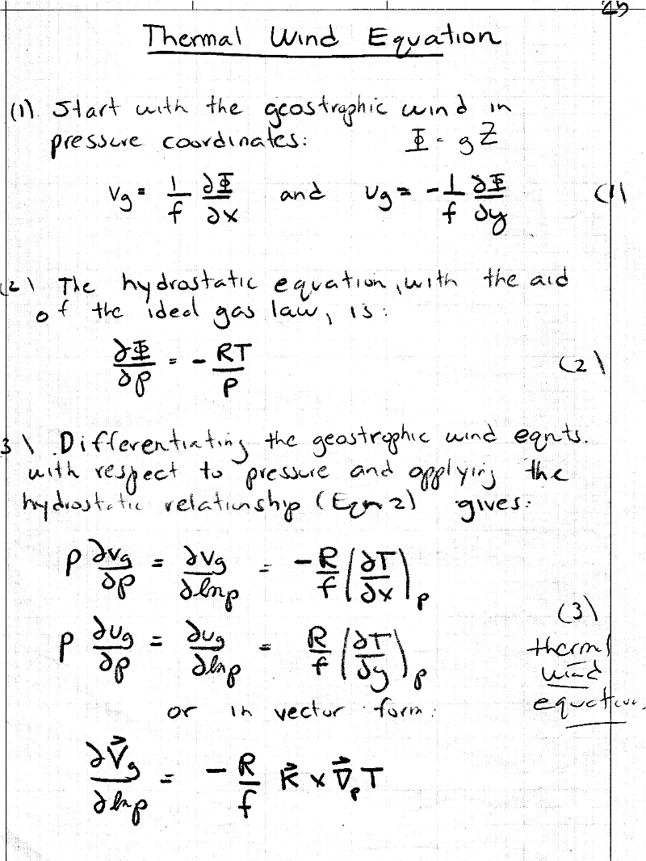

Slide 55
Origin of African Easterly Waves
An instability on the African easterly jet deriving energy from large vertical and horizontal wind shears.
Barotropic instability from large horizontal wind shear
Baroclinic instability from large vertical wind shear
Release of latent heat in convection can help initiate and support these waves.

Slide 56
Monsoons
Monsoon is a term from the Arabic "Mausin," or "the season of winds."
This referred to the seasonally shifting winds in the Indian Ocean and surrounding regions, including the Arabian Sea.

Slide 57
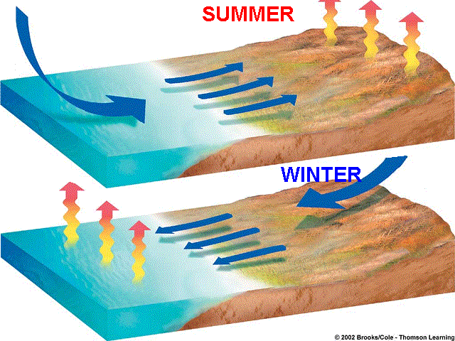
Essentially a large-scale sea breeze

Slide 58
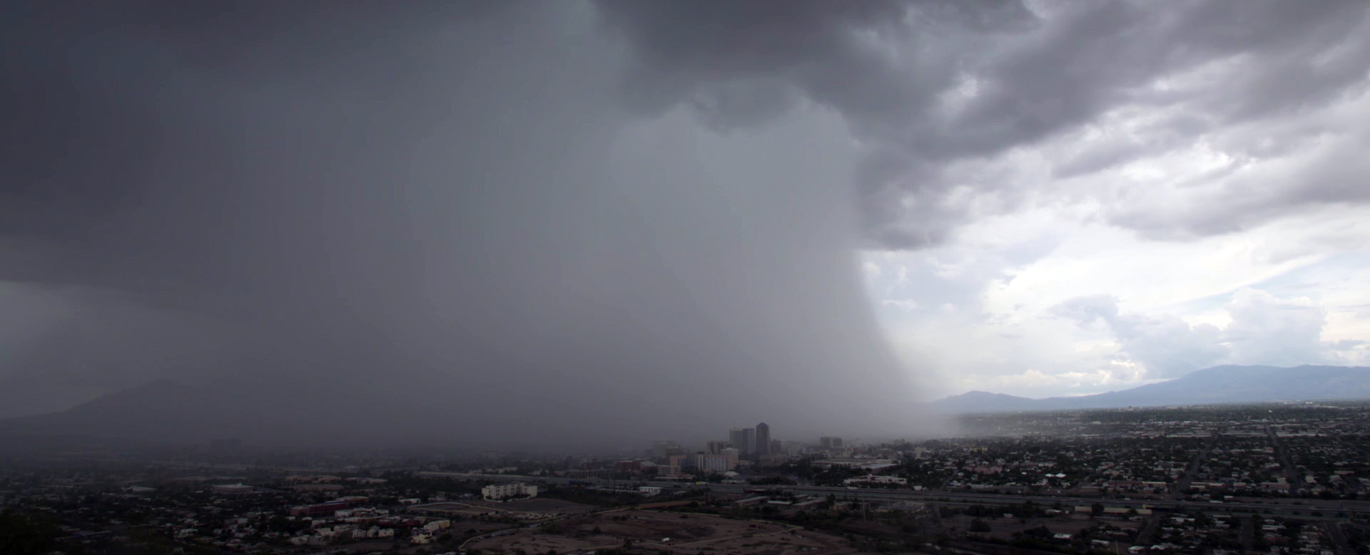
Monsoon Circulations Around the World
Occur in tropics and subtropics
Some well-known monsoons:
  India/China/SE Asia
  West Africa
  Soutthwest U.S.

Slide 59
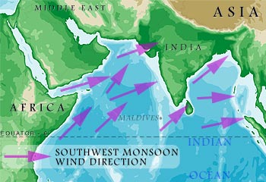
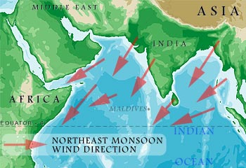
Asian/Indian Monsoon
Summer
Winter

Slide 60
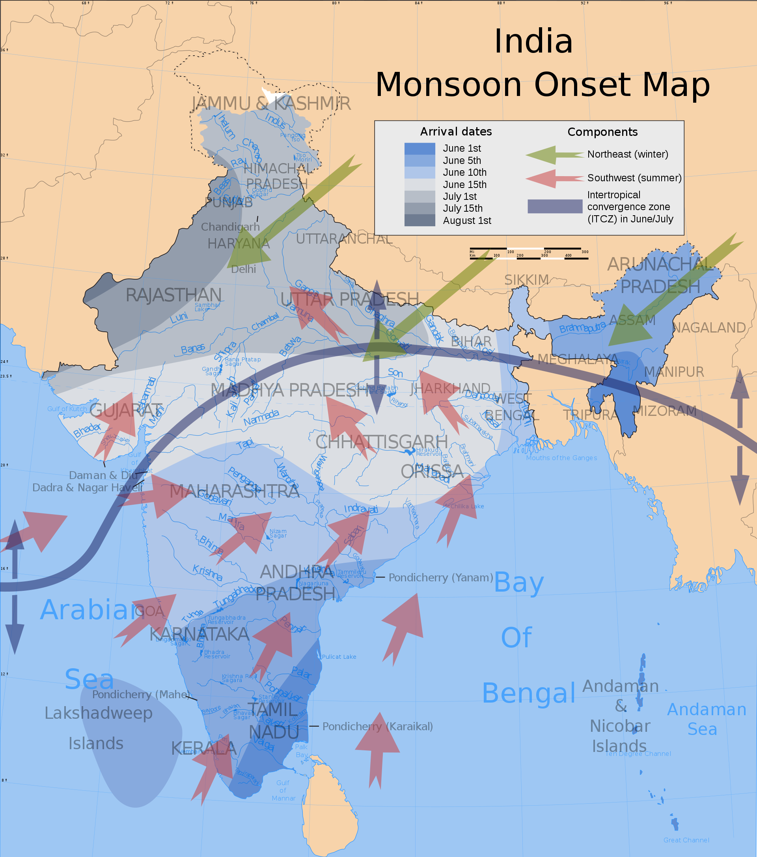
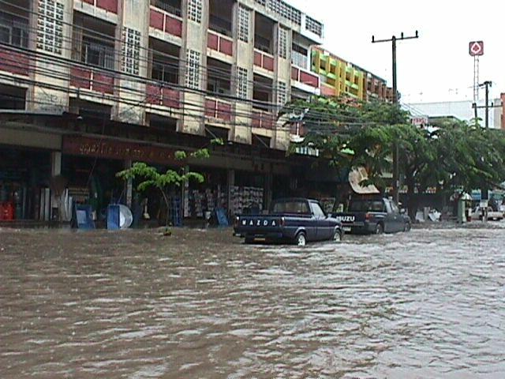
Indian Monsoon

Slide 61
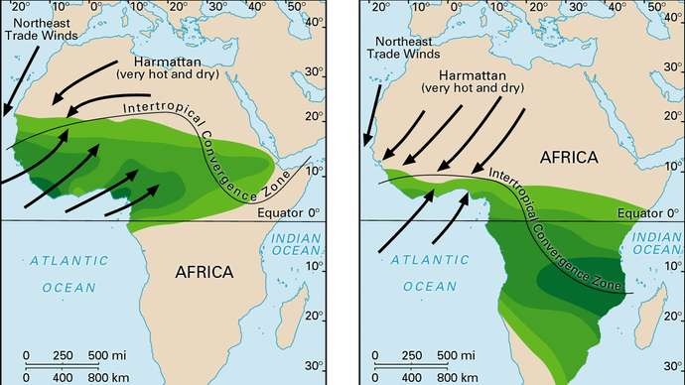
West African Monsoon
Summer
Winter

Slide 62
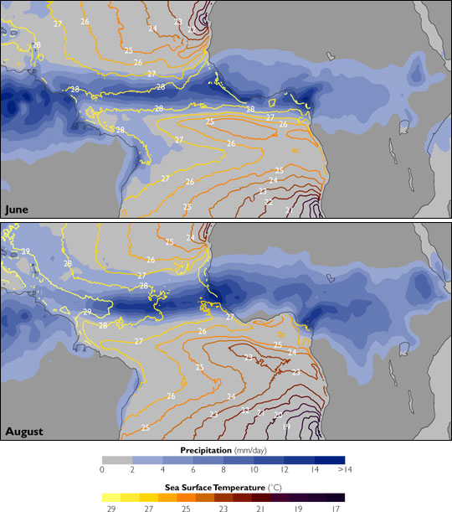

Slide 63
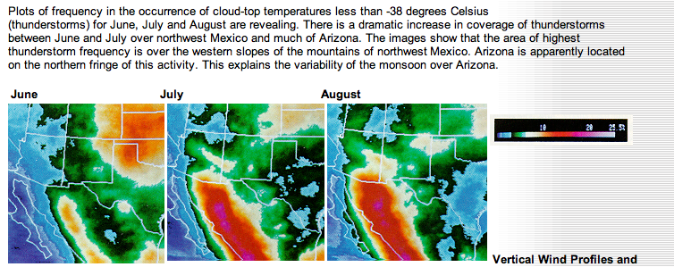
Southwest or North American Monsoon

Slide 64
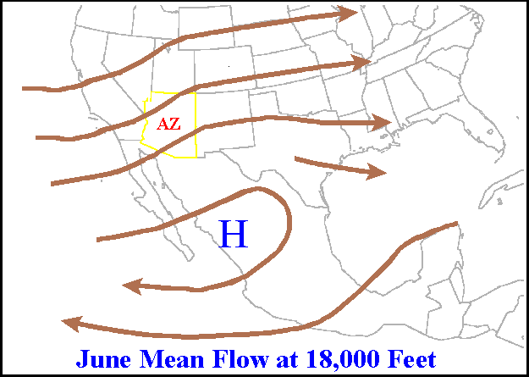
Synoptic Evolution

Slide 65


Slide 66


Slide 67

The U.S. Southwest is Wettest During Monsoon Season!

Slide 68


Slide 69

Monsoon Video https://www.youtube.com/watch?v=TC75USRhdho

Slide 70

Upper-Level Features over the Tropics

Slide 71

200 hPa Easterly Jet
Most prominent in July
Extends from SE Asia to eastern Africa
Results from the temperature gradient between the Himalayas and the Indian Ocean at higher levels

Slide 72


Slide 73

Strongest in Summer

Slide 74

Explanation: Thermal Wind
Elevated Himalayas warm aloft (particularly during summer (sensible and latent heat)
Cooler over Indian Ocean
With warming to north, easterly flow gets stronger with height

Slide 75
Don’t Forget!

Slide 76

Tropical Upper Tropospheric Troughs (TUTTs)

Slide 77

A TUTT Over the Pacific

Slide 78

TUTT
Produced by subsidence near and just above tropopause
Can assist tropical cyclone genesis and intensification
About 20% of hurricanes/tropical storms can be traced to TUTTs

Slide 79

Hurricanes and Tropical Storms

Slide 80
Some Tropical Terminology
Easterly Wave:
  A wavelike disturbance in the tropical easterly winds that moves from east to west. Such waves can grow into tropical depressions.
Tropical disturbance: Often the earliest stage of a tropical cyclone and usually develops from an easterly wave.
  Normally an organized area of thunderstorms that forms in the tropics and persists for more than 24 hours.
  Low pressure might form at the surface, but winds remain below 30 mph. No closed wind circulation.

Slide 81
Tropical depression (TD): A tropical cyclone with a closed circulation and maximum sustained winds near the surface of less than 34 knots (39 mph.) Tropical depressions are listed only with a number, not a name.
Tropical storm: Tropical cyclone with winds of 35-64 knots (39 to 74 mph). In most of the world, a storm is given a name when it reaches tropical storm intensity.
Hurricane: A tropical cyclone with winds greater than 64 knots (74 mph). Normally this name is applied to such storms in the Atlantic Basin and the Pacific Ocean east of the International Date Line. Called typhoons over the western Pacific.

Slide 82
Midlatitude Versus Tropical Storms
Midlatitude Tropical
Large temperature gradients | Weak temperature gradients
Large Vertical Wind Shear Environment | Weak Wind Shear Environment
Energy source: baroclinic instability from temperature gradients | Latent heat release, air-sea interactions
1000-2000 km in size | 500-1000 km in size
Form over land and water and can maintain itself over land | Form over warm tropical waters, die over land
Mainly stratiform clouds | Highly convective

Slide 83

Structures

Slide 84

Key Structures

Slide 85


Slide 86


Slide 87


Slide 88



Slide 89


Slide 90

Inside the Eye

Slide 91


Slide 92


Slide 93

Saffir-Simpson Scale
(remember: these are sustained winds)

Slide 94

The Biggest Threat from Tropical Storms is NOT the Winds, but the Storm Surge

Slide 95



Slide 96

Storm Surge Origin: winds pushing water up on coast, increased waves, low pressure also raises sea level

Slide 97

Reverse or Inverted Barometer Effect

Slide 98

Hurricane Climatology (Avoids the Equator)

Slide 99

Seasonal Variation: July to October peak

Slide 100

Origins
Most hurricanes and typhoons begin as easterly waves
Easterly waves to tropical disturbance to tropical depression to tropical storm to hurricane

Slide 101


Slide 102
Energy Source of Tropical Storms/Hurricanes
Latent heat release is critical, which requires warm water that results in lots of evaporation.
Associated warming causes pressure to fall, which results in more moisture coming into storm, more latent heating: positive feedback!
CISK: Conditional Instability of the Second Kind
WISHE: Wind Induced Surface Heat Exchange

Slide 103

CISK versus WISHE: Both are Positive Feedbacks Associated with Latent Heating
CISK: More latent heating, caused pressure drops, which sucks in more water vapor, leading to more latent heating.
WISHE: More latent heading, produces more pressure drops, which increases winds, which brings pulls more moisture off the ocean, and thus latent heating in storm

Slide 104

More wind produces more sea spray which injects more moisture into atmosphere

Slide 105
Tropical Cyclogenesis Requirements
Warm ocean waters of at least 26.5C/ 80F throughout a sufficient depth (at least 50 m/ 150 ft).
  Warm waters are necessary to fuel the heat engine of the tropical cyclone.
An atmosphere which cools fast enough with height such that it is potentially unstable to moist convection.
  Thunderstorm activity which allows the heat/moisture stored in the ocean waters to be into tropical cyclones

Slide 106
Requirements
Relatively moist layer near the mid-troposphere (5 km [3 mi]).
  Dry mid levels are not conducive for continuing development of widespread thunderstorm activity.
A minimum distance of at least 500 km [300 mi] from the equator.
  For tropical cyclogenesis to occur, there is a requirement for non-negligible amounts of the Coriolis force to provide the circulation.

Slide 107
Requirements
A pre-existing near-surface disturbance with sufficient vorticity and convergence.
  Requires a weakly organized system with spin and low-level inflow.
Low values (less than about 10 m/s) of vertical wind shear between the surface and the upper troposphere.
  Large values of vertical wind shear disrupt the developing tropical cyclone by interfering with the organization of deep convection around the cyclone center.

Slide 108
Hurricane Prediction: A Mixed Report
During the past thirty years there has been substantial improvement in hurricane track forecasts as computer models improved and more data became available to describe their environment.
Over the same period only minimal improvement in hurricane intensity forecasts.

Slide 109


Slide 110


Slide 111


Slide 112


Slide 113

Hurricane Katrina
48-h Before: Virtually a Perfect Forecast of Track

Slide 114

Better synoptic forecasts and more information for the environment have aided prediction of hurricane tracks
NOAA P3

Slide 115

NOAA G-4

Slide 116


Slide 117

These aircraft can deploy dropsondes in and around storms

Slide 118


Slide 119


Substantial Promise
The use of higher resolution prediction and more detailed data around and in hurricanes should result in better intensity predictions.
15-km grid spacing
1.67 km grid spacing

Slide 120

New Research Shows the Importance of Warm, Dry, Dust-laden air off the Sahara: The Saharan Air Layer (SAL)

Slide 121


Slide 122
SAL
The SAL can cover an area the size of the continental U.S. and has been tracked as far west as the Caribbean Sea and Central America.
SAL can weaken tropical storm activity by warming aloft (reduces lapse rate)

Slide 123

Extratropical Transition (ET)
A significant number of tropical cyclones move into the midlatitudes and transform into extratropical cyclones.
As they do so they take on the structural characteristics of midlatitude cyclones and switch energy sources (latent heating to baroclinic instability)

Slide 124

ET
During ET a cyclone acquires increased forward motion and intensifies substantially, so that such systems pose a serious threat to land and maritime activities.
Often poorly forecast by current numerical models, associated with periods of poor synoptic predictability over a wide area downstream.

Slide 125

Satellite
Sequence

Slide 126

Superstorm Sandy Experienced ET

Slide 127

Superstorm Sandy Experienced ET

Slide 128


Slide 129

Climo Tracks of ET Systems

Slide 130
Some Big Impacts of ET
Severe flooding associated with the ET of Tropical Storm Agnes in 1972
Hurricane Hazel (1954) resulted in 83 deaths in the Toronto area of southern Ontario, Canada. In the northwest Pacific, severe flooding and landslides have occurred in association with ET.
Tropical Storm Janis (1995) over Korea, in which at least 45 people died and 22, 000 people were left homeless.
The Columbus Day Storm (1962) was an ET

Slide 131




http://oregonstate.edu/~readw/October1962.html

Slide 132

Columbus Day Storm Started as Hurricane Freda

Slide 133
ET and Predictability
ET events are often not predicted well by today’s synoptic models (e.g., GFS)
The interaction of ET’s with the midlatitude jet stream/baroclinic zone can result in the production of Rossby wave trains/packets that can have a large impact on downstream flow.
ET events are often associated with periods of poor predictability over large areas downstream of the transition.

Slide 134



MOTIVATION: IMPROVED WEATHER FORECASTS
Impacts on Numerical Model Performance
The poleward movement of a tropical cyclone often results in a period of reduced forecast accuracy in operational numerical global weather prediction models
Hurricane
Maria
TY Nabi
TY Saola

Slide 135
Madden Julian Oscillation
(MJO)
The MJO is an eastward moving disturbance of clouds, rainfall, winds, and pressure that moves eastward in the tropics and returns to its initial starting point in 30 to 60 days on average.

Slide 136


Slide 137


Slide 138

Cloud Height Anomalies
Blue is higher

Slide 139
The MJO not only influences the tropics, but has an impact on midlatitudes…including our region!

Slide 140


Slide 141

Diurnal Circulations and Diurnal Variability is Large in the Tropics
Not surprising with large diurnal heating
Strong sea breeze circulations
Large diurnal precipitation variations

Slide 142

Large diurnal variations in precipitation on coasts of big islands in tropics due to strong sea breezes and mountain slope circulations

Slide 143

Strong Sea Breeze Circulations

Slide 144
Sea Breeze Circulations
Start at the coastline and build both offshore and inland
Typically have a scale of 50-100 km, but can be more.
Lends some predictability to tropical weather.

Slide 145
El Nino Southern Oscillation (ENSO)
A 3-7 year quasi-periodic variation between:
  El Nino
  Neutral
  La Nina
Has large influence both in the tropics and midlatitudes.
Main source of forecast skill beyond a few weeks.

Slide 146


Slide 147

Walker Circulation
Walker Circulation

Slide 149


Slide 150

The Pacific Ocean is Like A Big Bathtub

Slide 151


An Important Measure is the Surface Temperature in the Tropical Pacific
Nino 3.4 area is frequently
used

Slide 152
Why do we care?
The circulations in the midlatitudes are substantially different in El Nino, Neutral, and La Nina years.
Since the temperature of the tropical Pacific changes relatively slowly, this gives meteorologists insights into the weather over the next several months.

Slide 153


Slide 154

El Nino – weak Aleutian High

Slide 155
La Nina – strong Aleutian High

Slide 156
Great Web Site on ENSO: Climate Prediction Center http://www.cpc.ncep.noaa.gov/products/precip/CWlink/MJO/enso.shtml

Slide 157
Who is responsibility for tropical storm prediction in the U.S?
National Hurricane Center (Miami):
  Atlantic, Caribbean, Gulf of Mexico, E. Pacific
Joint Typhoon Warning Center (Hawaii):
  Joint between NOAA/Air Force/Navy
  Pacific and Indian Ocean

Slide 158


Slide 159
The End

